Slide 1



Implementation of APB Protocol using FPGA
Project ID: 26037
By
Student 1: Kirti Kumar Roll No: ECE 201910212
Student 2: Kumar Anurag
Roll No: ECE 201910364
Under the guidance of
Dr. M. Suresh
Notes:
B-TECH PROJECT MID-SEM PRESENTATION 2011
BY KHUSHBU KHAN & ISAN SAHOO

Slide 2
Contents
Problem Statement
Introduction
FPGA Introduction
Need for APB
Why FPGA
APB Signal Description
State Diagram
Output Waveforms & post Implementation layout
RTL Schematic
Utilization Reports
FPGA Mapping
Conclusion
References
Notes:
B-TECH PROJECT MID-SEM PRESENTATION 2011
BY KHUSHBU KHAN & ISAN SAHOO
2

Slide 3
Problem Statement
Longer development cycle for interfaces
Compatibility issues with different vendors
Bandwidth and Latency restrictions
Notes:
B-TECH PROJECT MID-SEM PRESENTATION 2011
BY KHUSHBU KHAN & ISAN SAHOO
3

Slide 4
Introduction
APB stands for Advanced Peripheral Bus
It’s an AMBA interconnect specification for low bandwidth peripherals
It was introduced by arm for connecting of peripherals with reduced complexity that doesn’t require high power of AHB or AXI interconnects.
It’s a non pipelined protocol that doesn’t support burst mode transfer of data.
Every data transfer takes at least two clock cycles to complete.
Notes:
B-TECH PROJECT MID-SEM PRESENTATION 2011
BY KHUSHBU KHAN & ISAN SAHOO
4

Slide 5
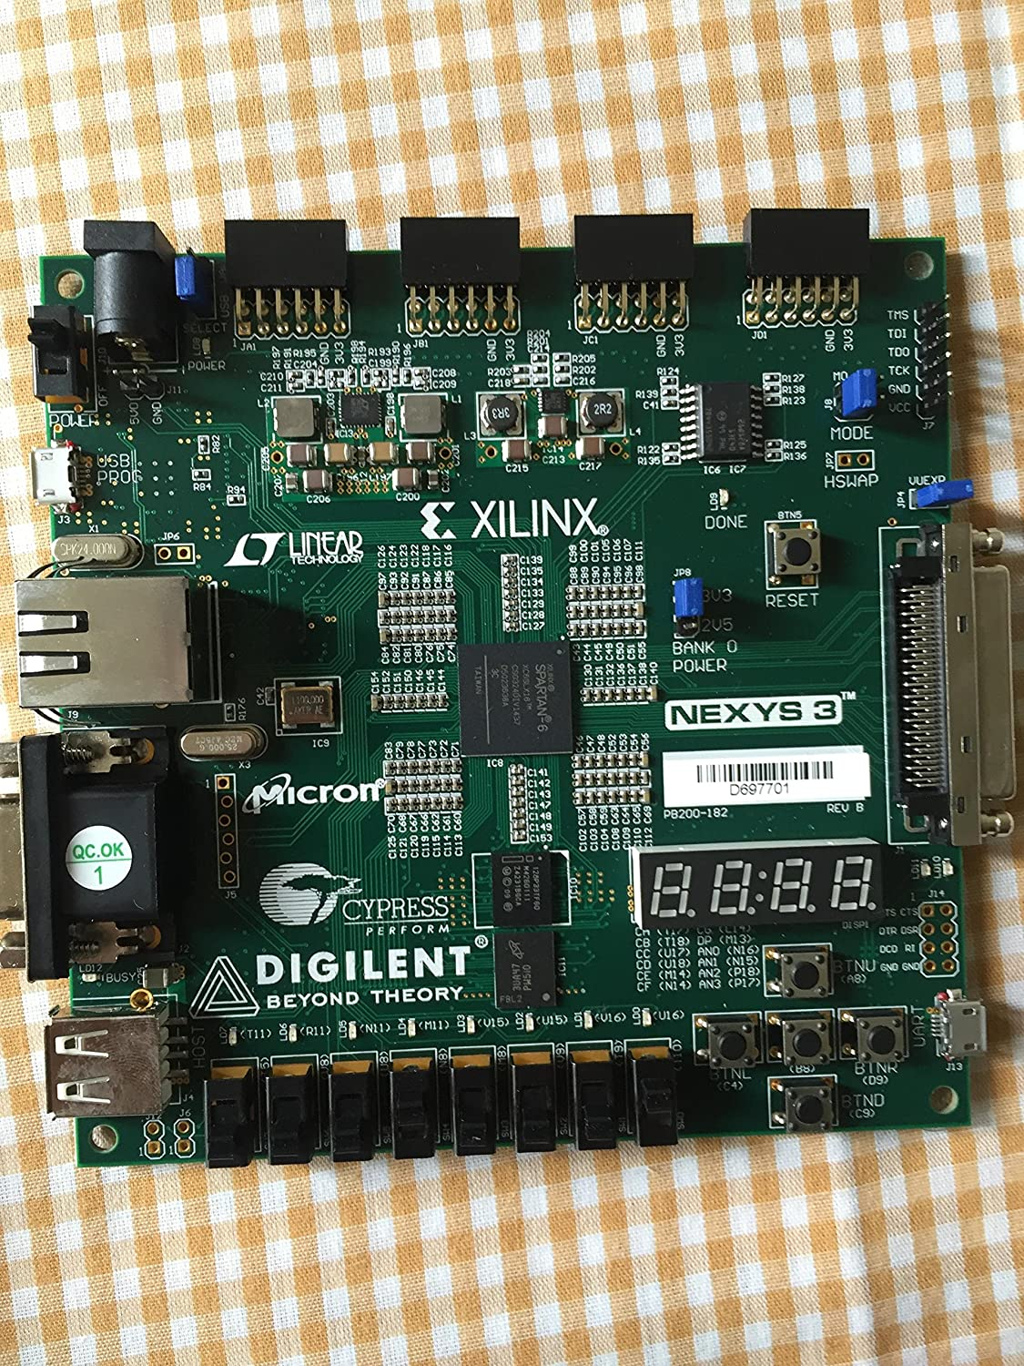
FPGA Introduction
It stands for Field Programmable Gate Array.
These are based around a matrix of configurable logic blocks (CLBs) connected via programmable interconnects.
FPGAs can be reprogrammed to desired application or functionality requirements after manufacturing.
We will be using Xilinx Spartan 6 FPGA board.
It contains :- 1) 6 Input LUT
2) 8 Switches and LEDs
3) 5 Push buttons
4) 4 digit 7-segment display
5) 32 DSP slices
Xilinx Nexys 3 FPGA board
(Spartan 6 family)
Notes:
B-TECH PROJECT MID-SEM PRESENTATION 2011
BY KHUSHBU KHAN & ISAN SAHOO
5

Slide 6
Need for APB
Synchronous circuit
Simple and highly optimized design
Low-power on-chip communication
Suitable for low bandwidth peripherals (up to 32 bits )
Low Latency
Flexible clock frequency (usually 80-100 MHz )
Interface for connecting peripherals like Timer, Keypad, UART, GPIO
Notes:
B-TECH PROJECT MID-SEM PRESENTATION 2011
BY KHUSHBU KHAN & ISAN SAHOO
6

Slide 7
Why FPGA
Highly customizable hardware
Faster time to market
Easy to debug and reprogram
Parallel processing capabilities
Higher processing power
Higher number of IO pins and connectors
Notes:
B-TECH PROJECT MID-SEM PRESENTATION 2011
BY KHUSHBU KHAN & ISAN SAHOO
7

Slide 8
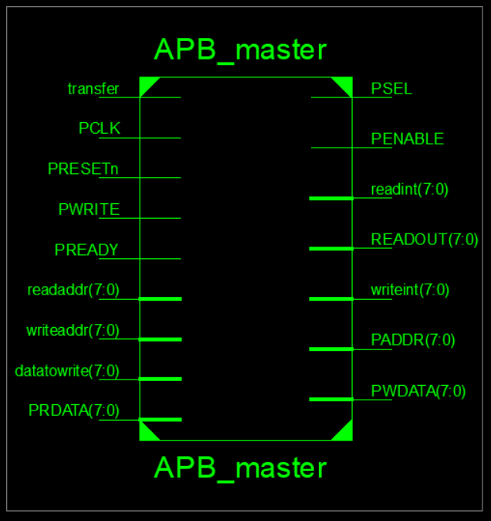
APB Signal Description
PCLK – Clock Signal
PRESET – Active high Reset signal
PSELx – Slave select signal for x number of slaves
PENABLE – Enable signal for subsequent cycles
PADDR – Address bus signal for transfer
PWRITE – Indicates Read/Write direction
PWDATA – Write data signal to slave
PRDATA – Read data signal from slave
PREADY – Slave ready signal
transfer – Initiates transfer from default state
readaddr – Address to read data from
writeaddr – Address to write data to
datatowrite – Data value to be written
User Input
Block Diagram
Notes:
B-TECH PROJECT MID-SEM PRESENTATION 2011
BY KHUSHBU KHAN & ISAN SAHOO
8

Slide 9
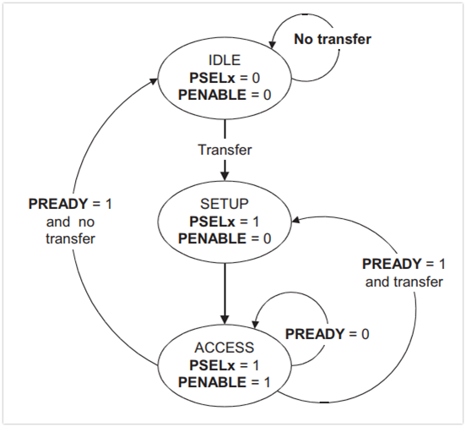
State Diagram
IDLE State
This is the default state of the APB interface. PSELx and PENABLE are both de-asserted.
SETUP State
When a transfer is required, PSELx is asserted. The interface only remains in the SETUP state for one clock cycle and always moves to the ACCESS state on the next rising edge of the clock.
ACCESS State
PENABLE is asserted in the ACCESS state. Exit from this state is controlled by the PREADY signal.
APB operating states
Notes:
B-TECH PROJECT MID-SEM PRESENTATION 2011
BY KHUSHBU KHAN & ISAN SAHOO
9

Slide 10
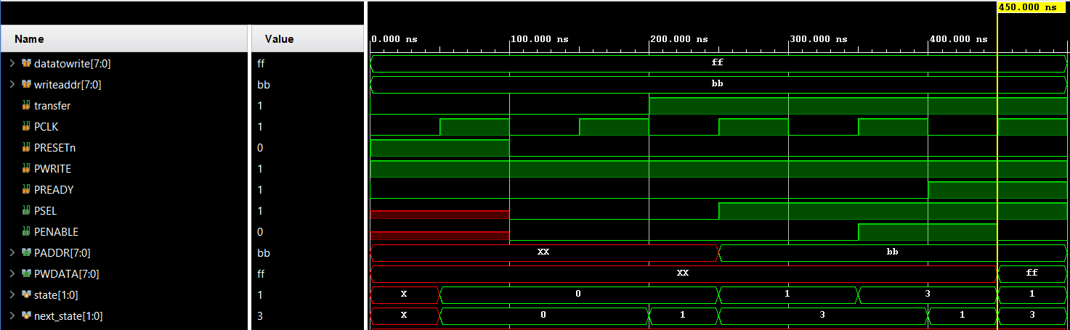
Output Waveforms & Post Implementation layout
Write Operation
IDLE
SETUP
ACCESS
Notes:
B-TECH PROJECT MID-SEM PRESENTATION 2011
BY KHUSHBU KHAN & ISAN SAHOO
10

Slide 11
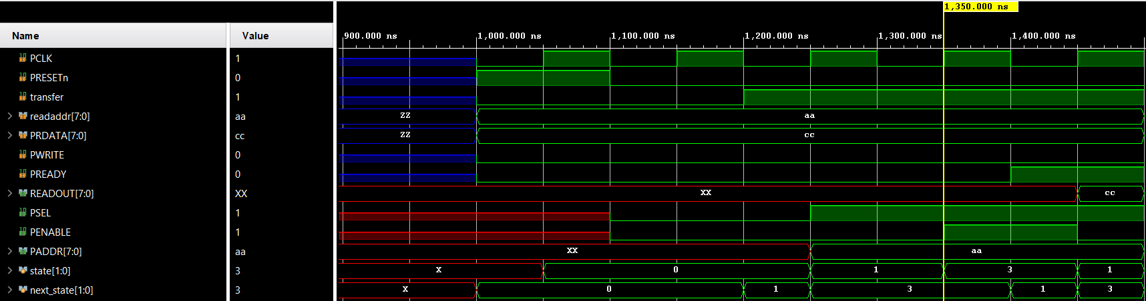
Output Waveforms & Post Implementation layout
Read Operation
IDLE
SETUP
ACCESS
Notes:
B-TECH PROJECT MID-SEM PRESENTATION 2011
BY KHUSHBU KHAN & ISAN SAHOO
11

Slide 12
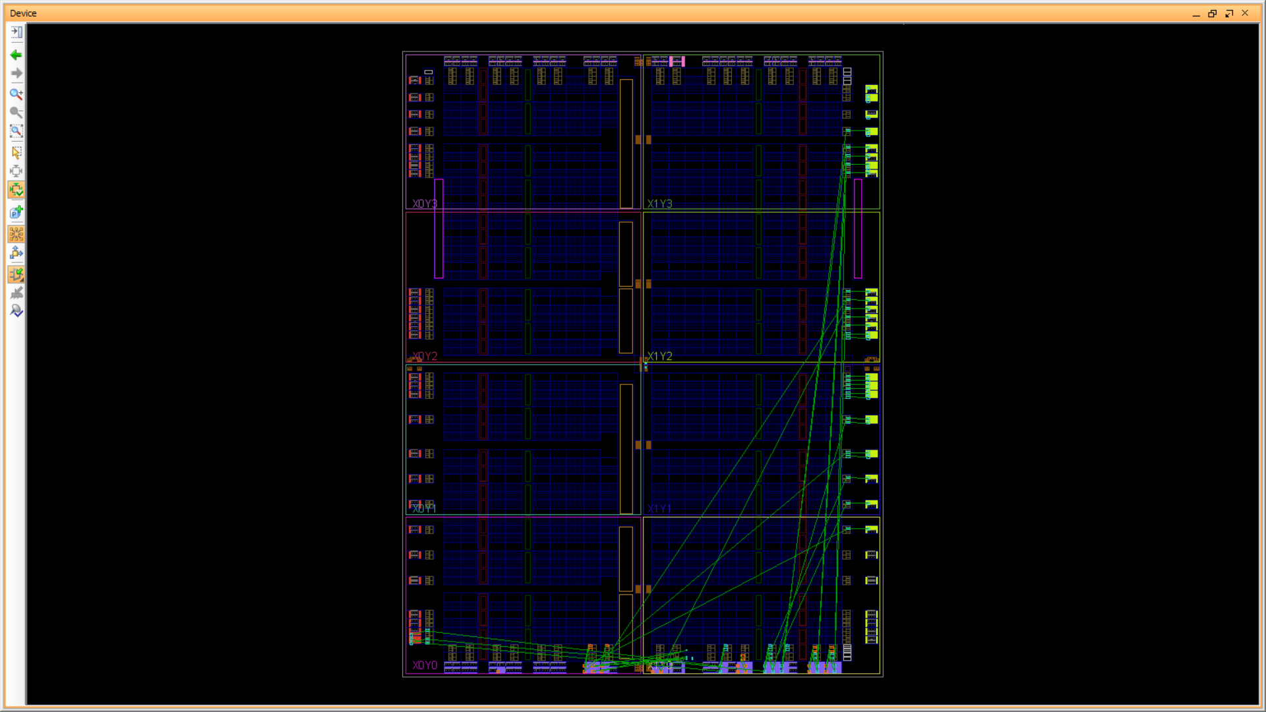
Output Waveforms & Post Implementation layout
Notes:
B-TECH PROJECT MID-SEM PRESENTATION 2011
BY KHUSHBU KHAN & ISAN SAHOO
12

Slide 13
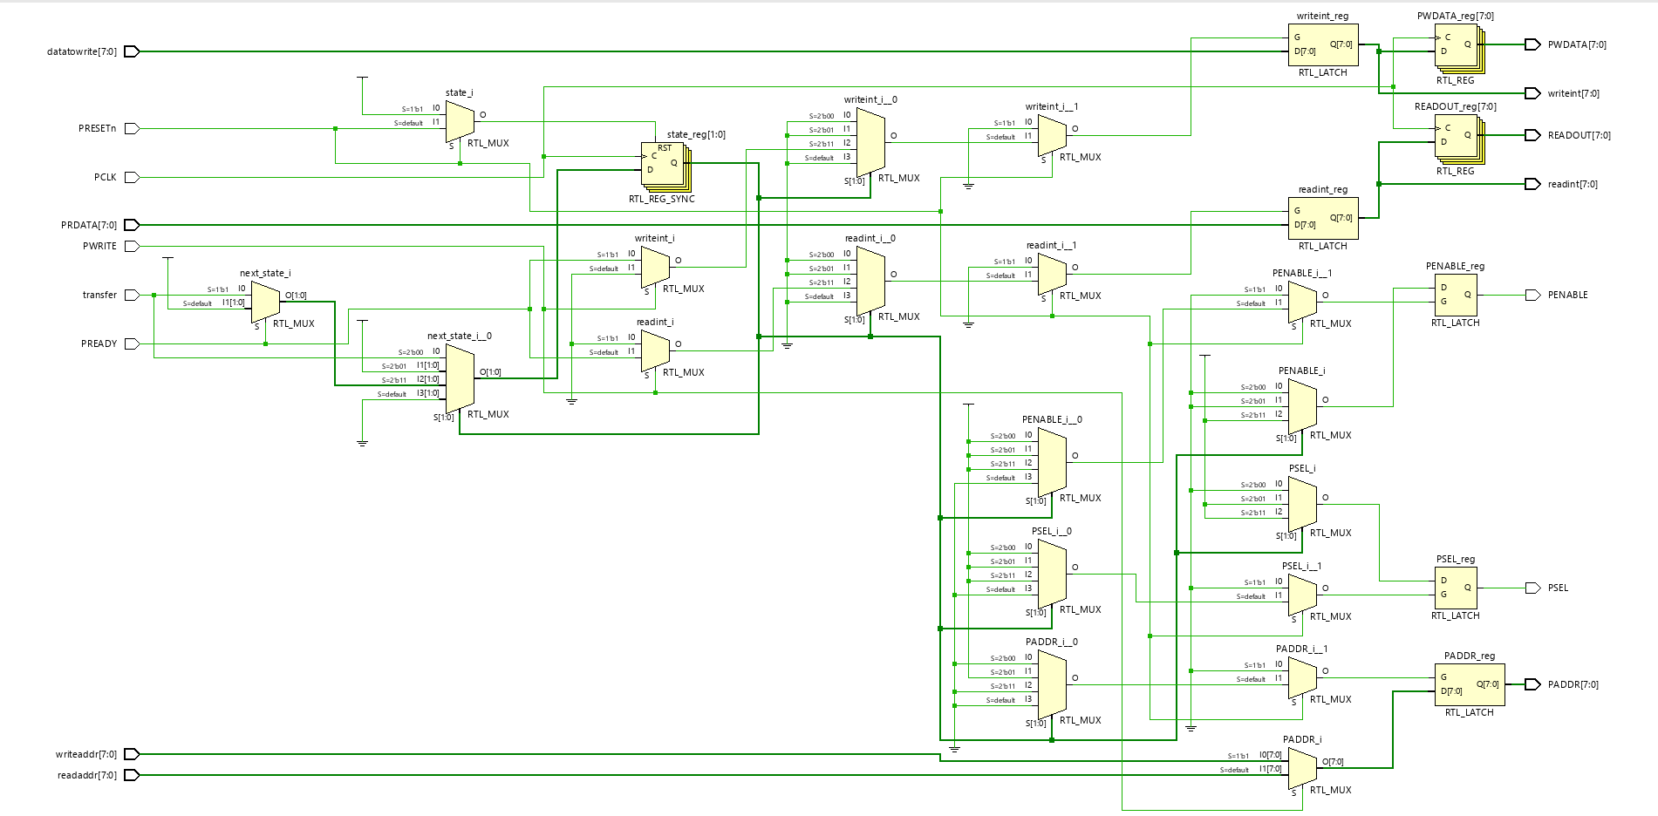
RTL Schematic
Notes:
B-TECH PROJECT MID-SEM PRESENTATION 2011
BY KHUSHBU KHAN & ISAN SAHOO
13

Slide 14
Utilization Reports
Post Synthesis
Post Implementation
Total On-chip power = 11.078 W
Junction Temperature = 52.3 °C
S. No. | Site Type | Used | Available | Utilization %
1 | Slice LUTs | 8 | 134600 | <0.01
2 | Slice Registers | 45 | 269200 | 0.02
3 | Bonded IOB | 79 | 285 | 27.72
4 | BUFGCTRL Clocking | 1 | 32 | 3.13
S. No. | Site Type | Used | Available | Utilization %
1 | Slice LUTs | 8 | 133800 | <0.01
2 | Slice Registers | 45 | 269200 | 0.02
3 | Bonded IOB | 79 | 285 | 27.72
4 | BUFGCTRL Clocking | 1 | 32 | 3.13
Notes:
B-TECH PROJECT MID-SEM PRESENTATION 2011
BY KHUSHBU KHAN & ISAN SAHOO
14

Slide 15
Timing Reports
Clock to Setup on destination clock PCLK
Source Clock | Src:Rise Dest:Rise | Src:Fall Dest:Rise
PCLK | 1.272
PRESETn | 6.887 | 0.763
Clock to Setup on destination clock PRESETn
Source Clock | Src:Rise Dest:Rise
PCLK | 4.978
Setup/Hold to clock PCLK
Source | Max Setup to clk (edge) | Process Corner | Max Hold to clk (edge) | Process Corner | Internal Clock(s)
PREADY | 0.563(R) | FAST | -0.094(R) | SLOW | PCLK_BUFGP
transfer | 0.618(R) | FAST | -0.177(R) | SLOW | PCLK_BUFGP
All values are in nanoseconds
Notes:
B-TECH PROJECT MID-SEM PRESENTATION 2011
BY KHUSHBU KHAN & ISAN SAHOO
15

Slide 16
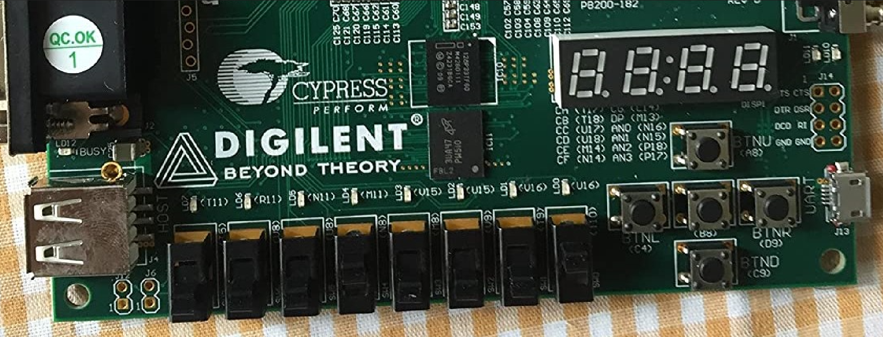
FPGA Mapping
PADDR
PENABLE
PSEL
PWDATA
READOUT
PRESETn
data_to_write
PWRITE
PREADY
PRDATA
transfer
Notes:
B-TECH PROJECT MID-SEM PRESENTATION 2011
BY KHUSHBU KHAN & ISAN SAHOO
16

Slide 17
Conclusion
APB Protocol is very important protocol which allows for efficient and allows for high speed data transfer from peripheral devices to the main core/master. This protocol is clock frequency flexible and facilitates the working of other protocols. This has become the standard protocol for on-chip interconnection.

Slide 18
References
[1] ARM, “AMBA Specification Overview”, http://www.arm.com/
[2] APB Example-AMBA system, Technical reference manual, ARM Inc.,1999.
[3] Akhilesh Kumar, Richa Sinha, “Design and Verification analysis of APB3 Protocol with Coverage,” IJAET, Nov 2011.
[4] Santhi Priya Sarekokku, K. Rajasekhar, “Design and Implementation of APB Bridge based on AMBA AXI 4.0,” IJERT, Vol.1, Issue 9, Nov 2012.
[5] VERILOG Reference Manual, http://www.accellera.com
[6] Samir Palnitkar, “Verilog HDL: A guide to Digital Design and Synthesis (2nd Edition), Pearson, 2008.

Slide 19
Thank You

